Slide 1
Big Data Analytics Survey:
How Enterprises are REALLY Using Big Data
Rebecca Shockley
Global Research Leader, Business Analytics
IBM Institute for Business Value

Slide 2
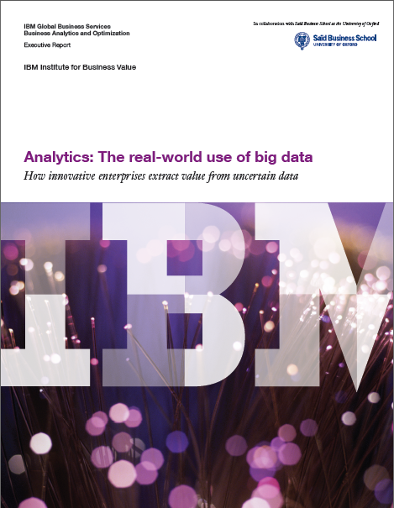
Download the study:
http://ibm.co/Ts2bpz

Slide 3
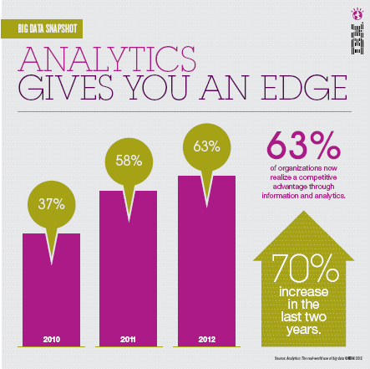
Source: Analytics: The real-world use of big data
© 2012 IBM, IBM Institute for Business Value

Slide 4
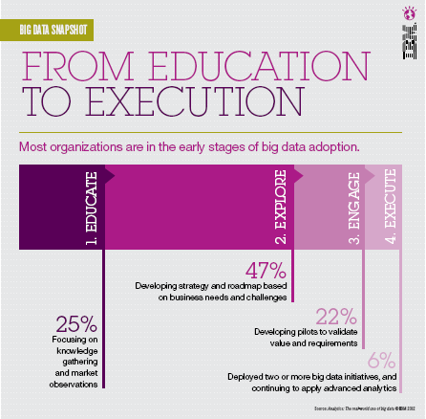
Source: Analytics: The real-world use of big data
© 2012 IBM, IBM Institute for Business Value

Slide 5
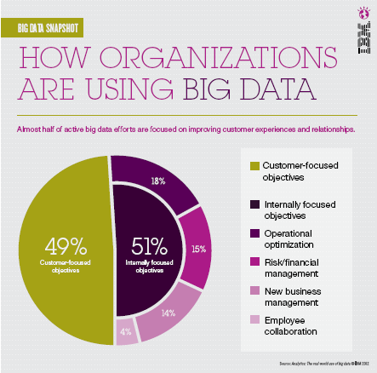
Source: Analytics: The real-world use of big data
© 2012 IBM, IBM Institute for Business Value

Slide 6
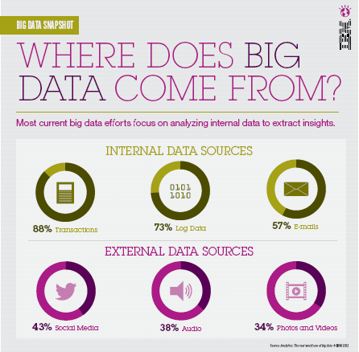
Source: Analytics: The real-world use of big data
© 2012 IBM, IBM Institute for Business Value

Slide 7
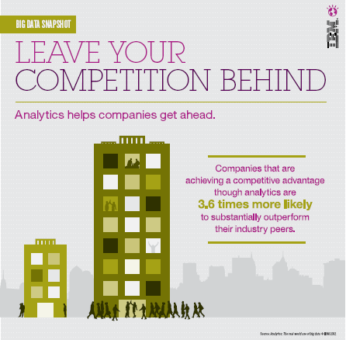
Source: Analytics: The real-world use of big data
© 2012 IBM, IBM Institute for Business Value

Slide 8
Pick up a free hard copy of the study at
IBM booth #508
Sponsors Pavilion
Download the study:
http://ibm.co/Ts2bpz

